Slide 1
Sprint Review: SVOT & Renewals
Sprint 3
31 Mar – 25 Apr

Slide 2





Sprint Overview
Sprint Numbers
Sprint Links
Key Dates
Weeks
4
Sprint 3 SIT Testing
28 Apr – 02 May
Sprint work Items Delivered
Work Items Delivered
38
Sprint 3 UAT Testing
12 May – 23 May
Work Items To Still Test
UAT Items Addressed
9
Update ”Grainger Testing” to “Yes” to confirm the work item has delivered the functionality detailed in the Acceptance Criteria
Sprint 2 UAT Testing
07 Apr – 02 May
Story Points Completed
77,75
Dashboard Overview
Release 1 Go Live
12 May

Slide 3
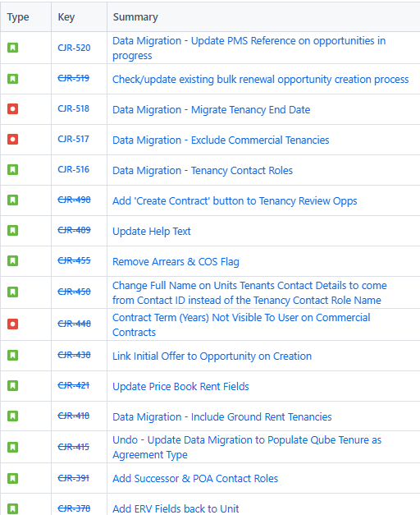
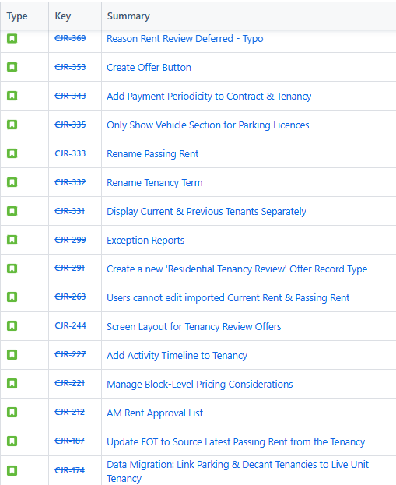
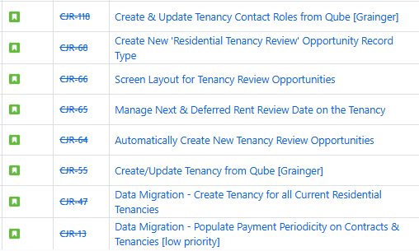
Work Items Delivered

Slide 4
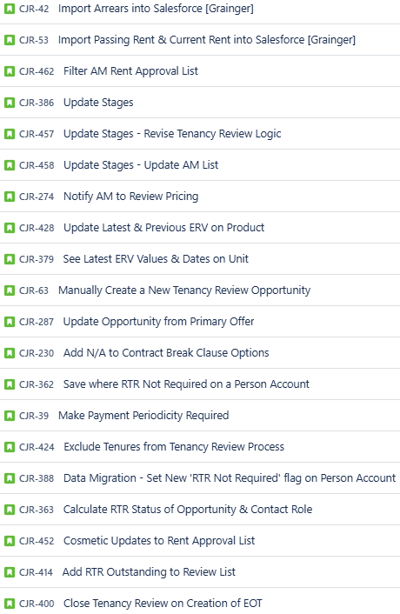
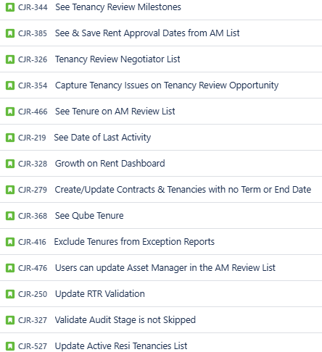
Work Items Planned for Next Sprint

Slide 5
General Items
Items Carried over to next Sprint | Reasons
UAT Feedback Items | UAT was extended by an additional week, UAT feedback was received late in the last week of this sprint.
Risk | Contributing factors | Impact | Decisions taken
New scope is being added | New insight from the Grainger team as to what is needed | To be determined | For discussion in the Program Management Review session
Issue | Contributing factors | Impact | Decisions taken
None
Decision | Description | Date

Slide 6

Thank You

